Slide 1
Organizational Behavior
Topic: Group Dynamics
Dr. C. Vijaya Banu
Associate Professor , School of Management
SASTRA Deemed University, Thanjavur – 613 401
vijayabanu@mba.sastra.edu

Slide 2
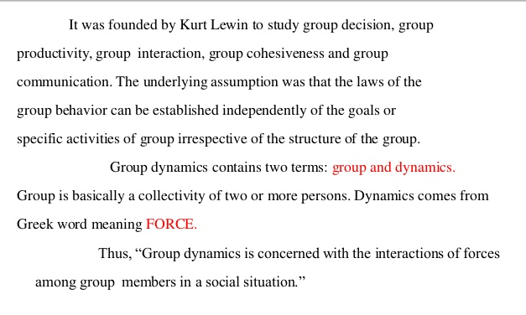
Group Dynamics

Slide 3
Group Dynamics
Structure of the group guiding interaction among group members. The social process by which people interact in a group environment. The influences of personality, power and behaviour on the group process.
Group dynamics is viewed from the perspective of internal nature of group: how they are formed, why groups are formed, what are their structure and process, and how they affect individual members, other groups and the organization
Group dynamics describes how a group should be organized and conducted. Democratic leadership member participation and overall co-operation are stressed in group dynamics

Slide 4
Group Dynamics
Group dynamics is the study of groups, and also a general term for group processes
. In group dynamics, the phrase "group process" refers to the understanding of the behavior of people in groups, such as task groups, that are trying to solve a problem or make a decision.
 An individual with expertise in group process, such as a trained facilitator, can assist a group in accomplishing its objective by diagnosing how well the group is functioning as a problem solving or decision making entity and intervening to alter the group operational behavior.
Group Dynamics" contains two words-
(i) Group- a social unit of two or more individuals who have in common a set of believes and values, follow the same norms and works for an establish able aim common. The members of the group share a set of common purpose, task or goals.
(ii) Dynamics- the flow of, coherent activities which as envisaged or will lead the group towards the establishment of its set goal.

Slide 5
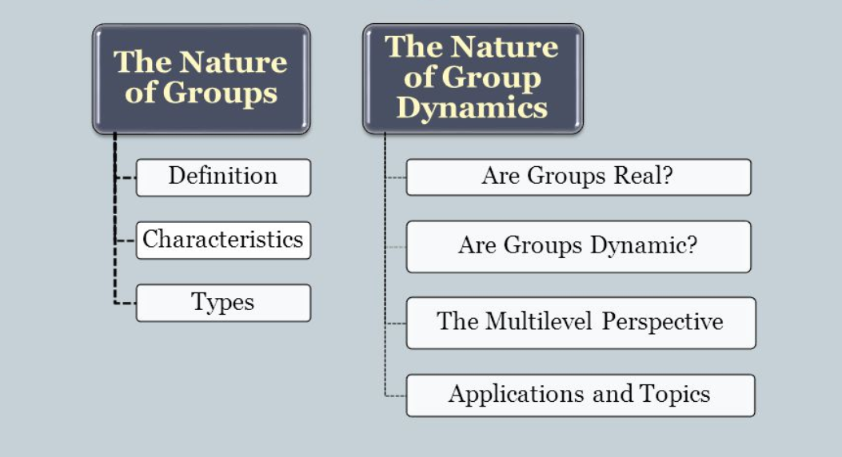
Group Dynamics

Slide 6
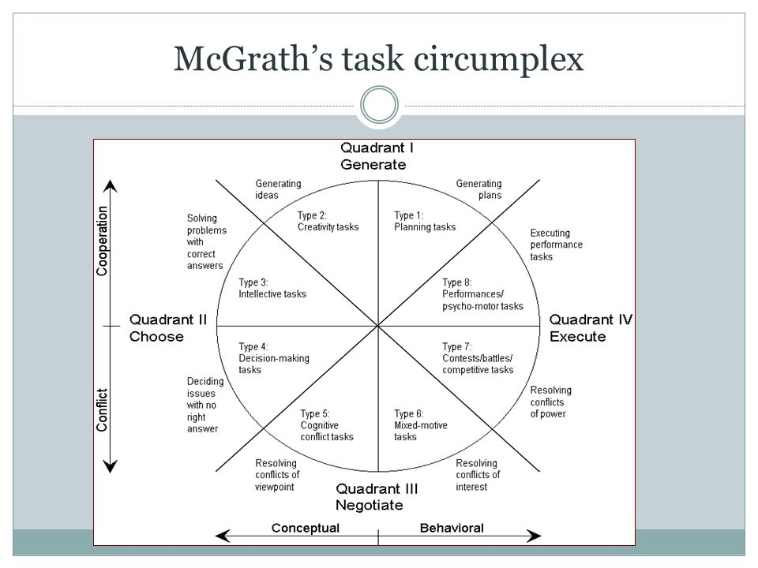

Slide 7
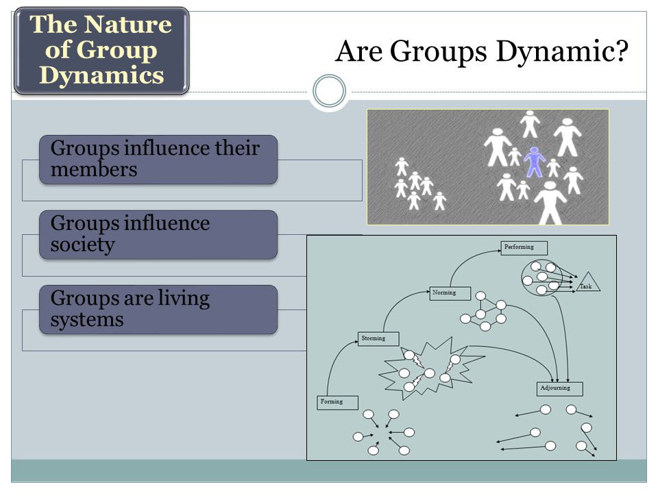

Slide 8
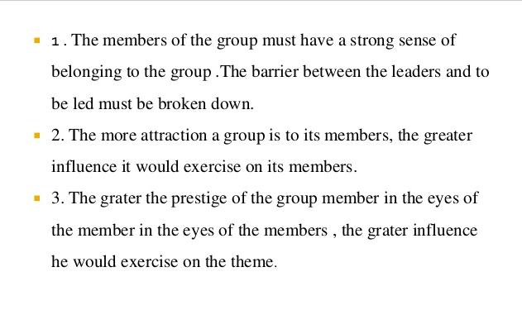
Principles

Slide 9
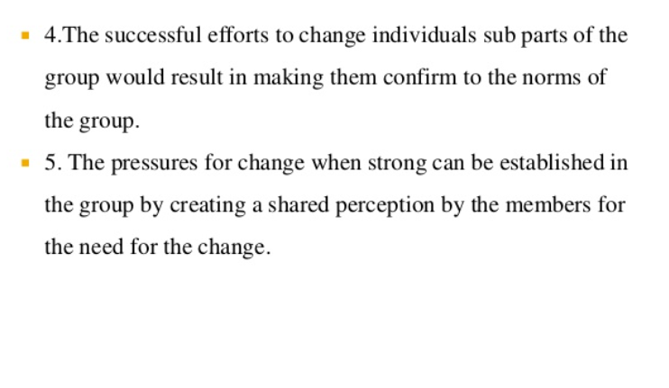
Principles

Slide 10
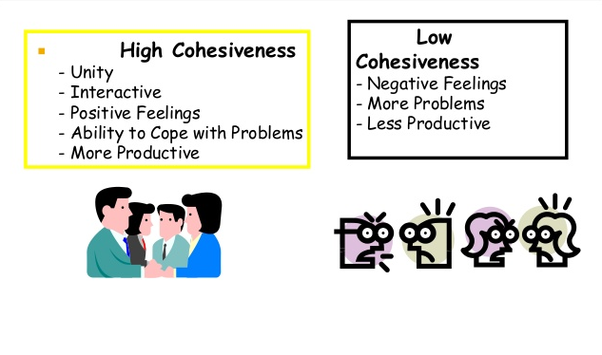
Importance

Slide 11
Group Cohesiveness
. According to Kurt Lewin , the founder of the movement to study group scientifically the phrase
When member of a group subscribe to common values, beliefs and objectives and when there is a high level of agreement between them on these matters and how best to achieve those adjectives of the group , a state of cohesiveness is said to exist

Slide 12
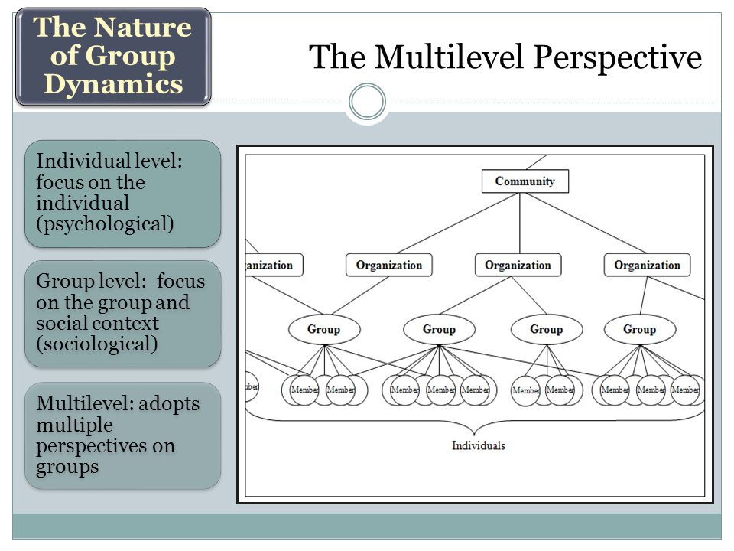

Slide 13
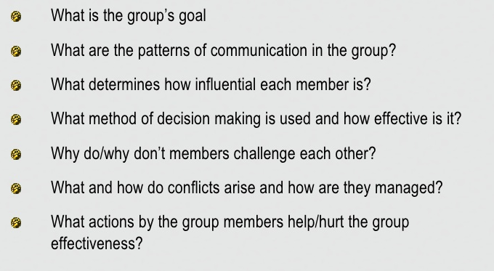
Practicing guidelines

Slide 14
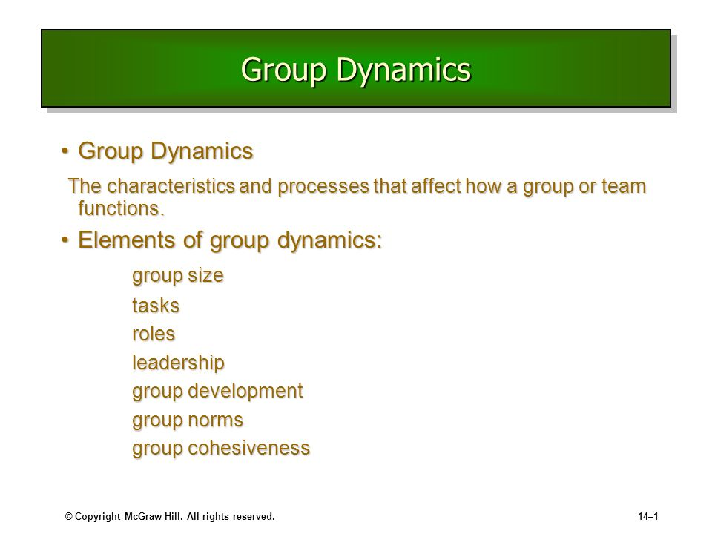

Slide 15
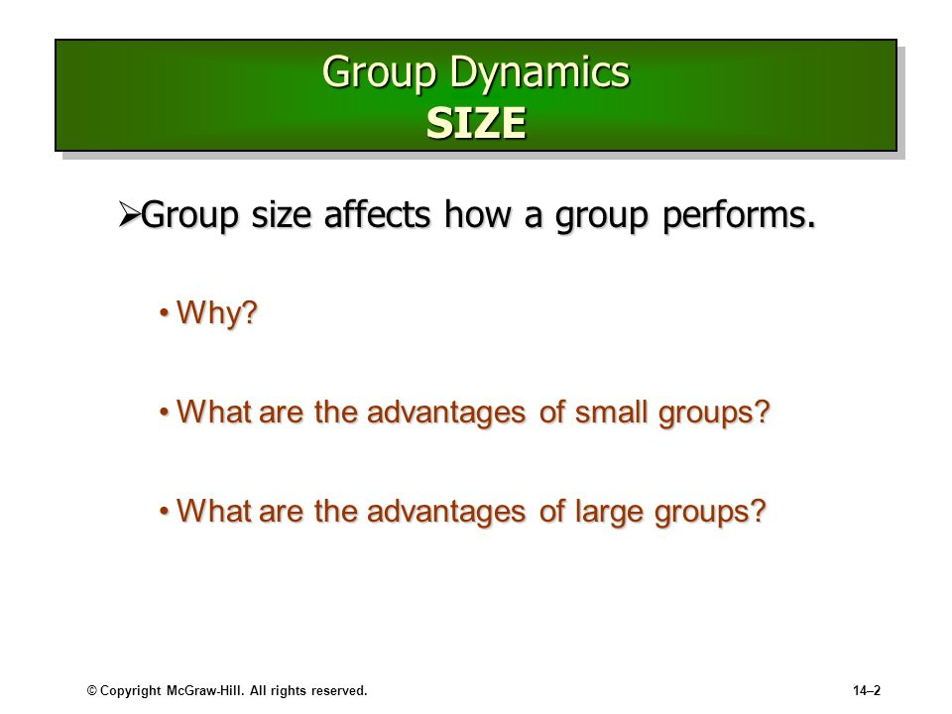

Slide 16
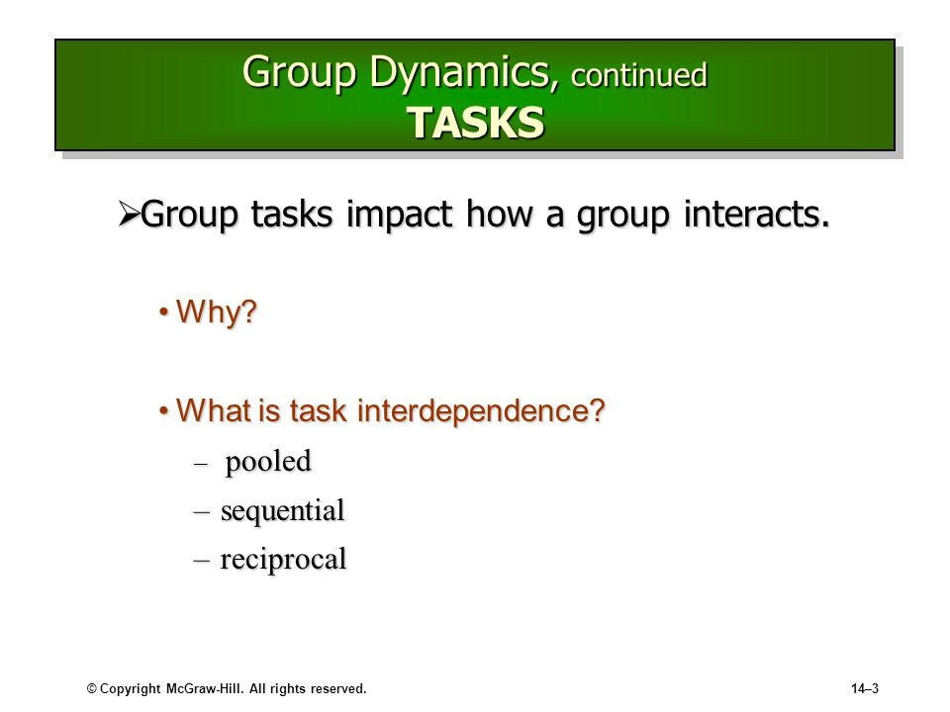

Slide 17
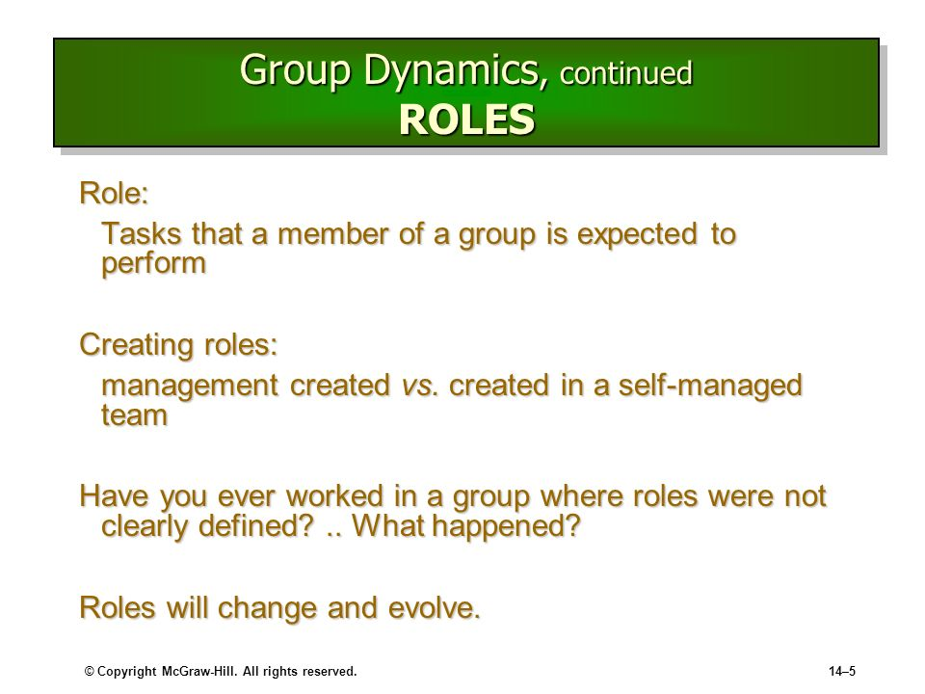

Slide 18
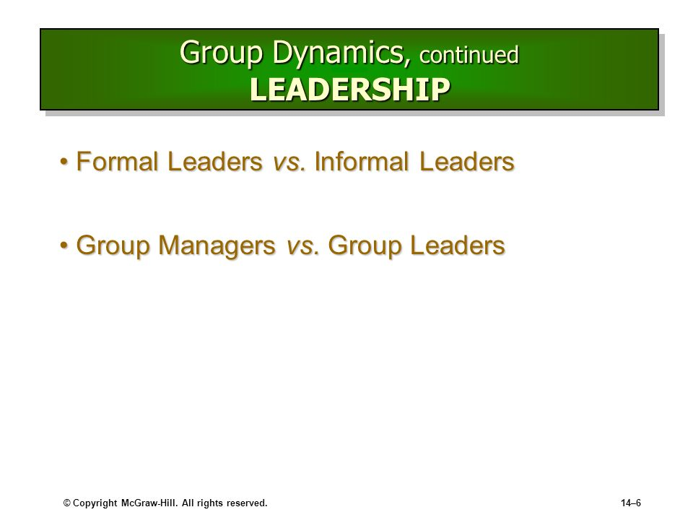

Slide 19
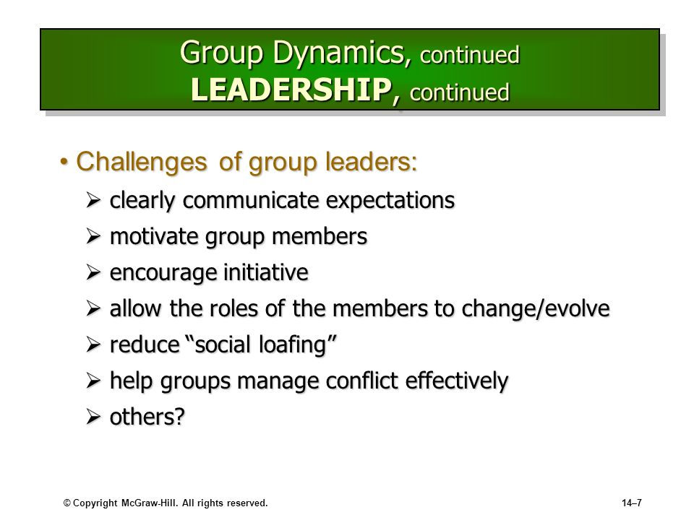

Slide 20
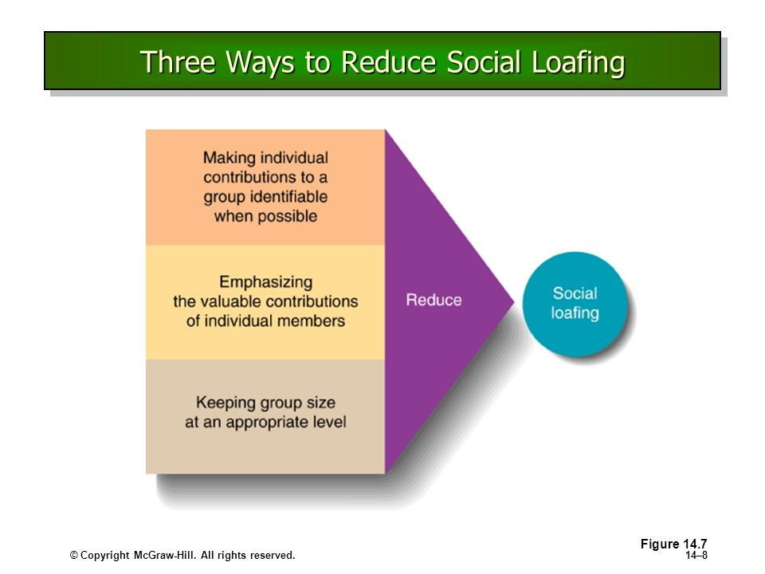

Slide 21
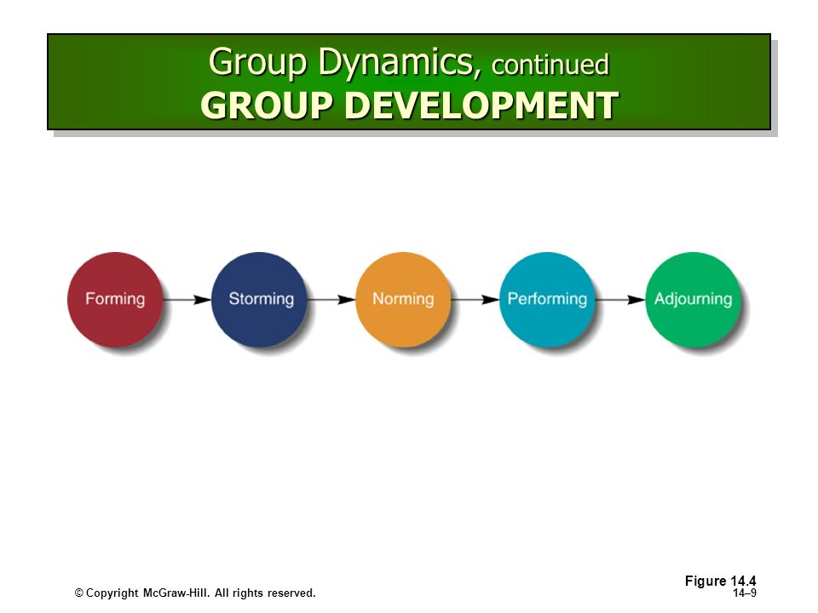

Slide 22
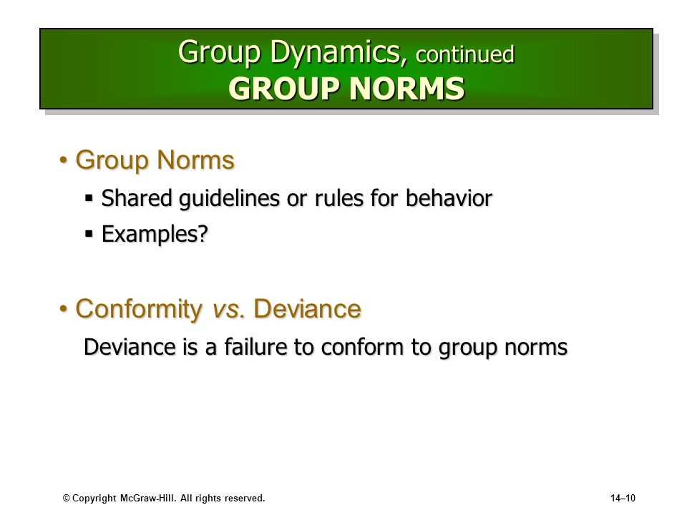

Slide 23
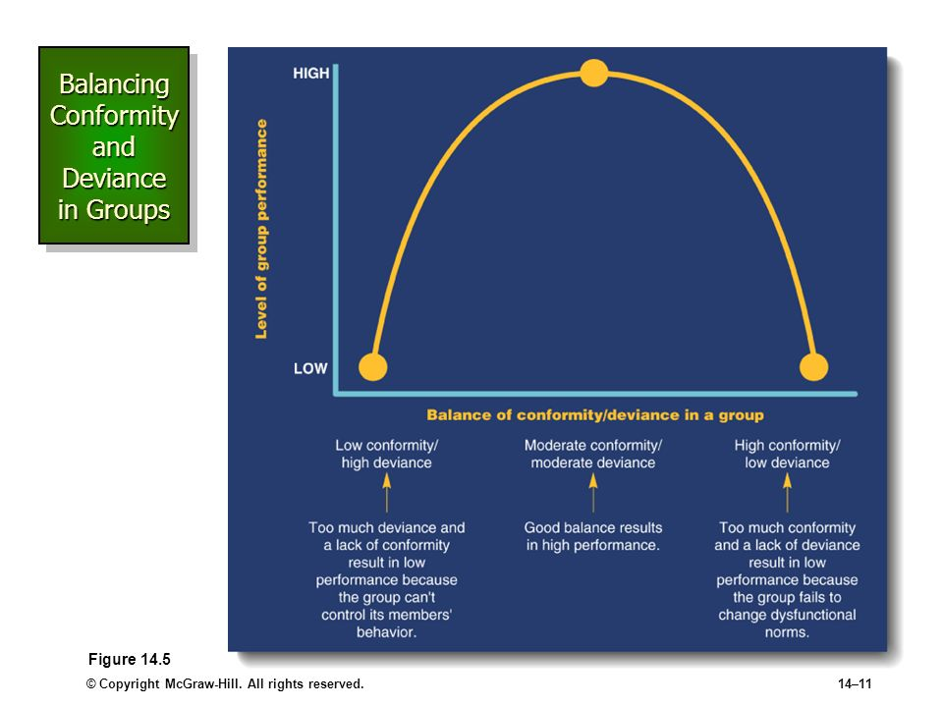

Slide 24
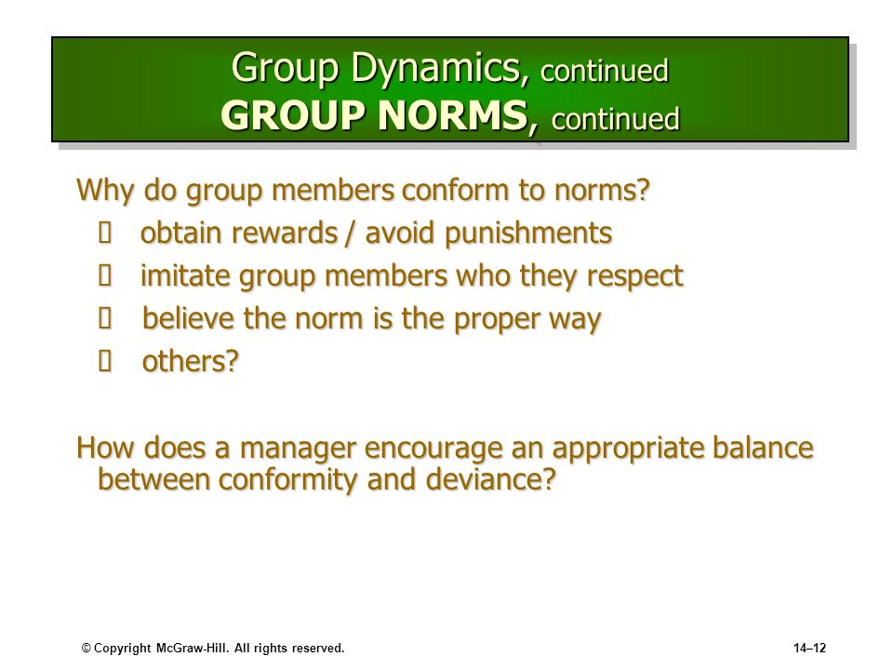

Slide 25
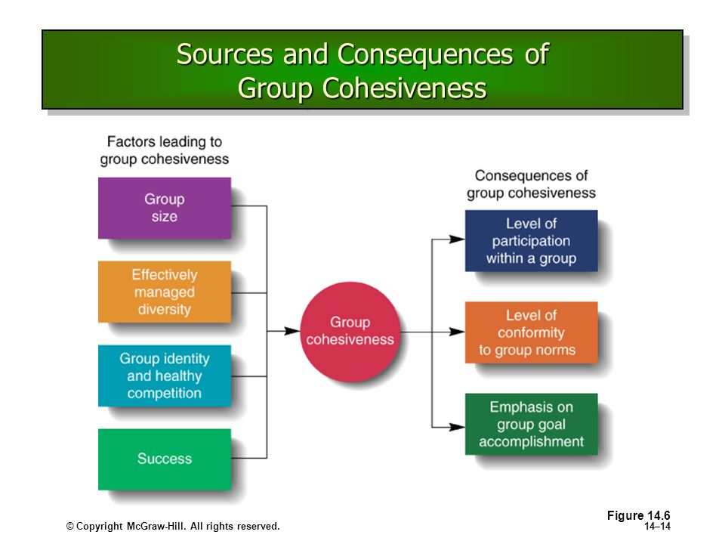

Slide 26
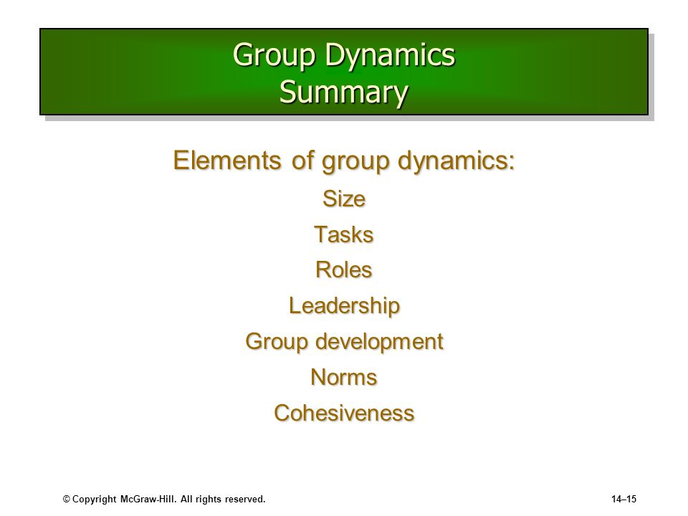

Slide 27
https://slideplayer.com/slide/5934352/
https://www.slideserve.com/carrington/group-dynamics
https://slideplayer.com/slide/9019415/

